Slide 1
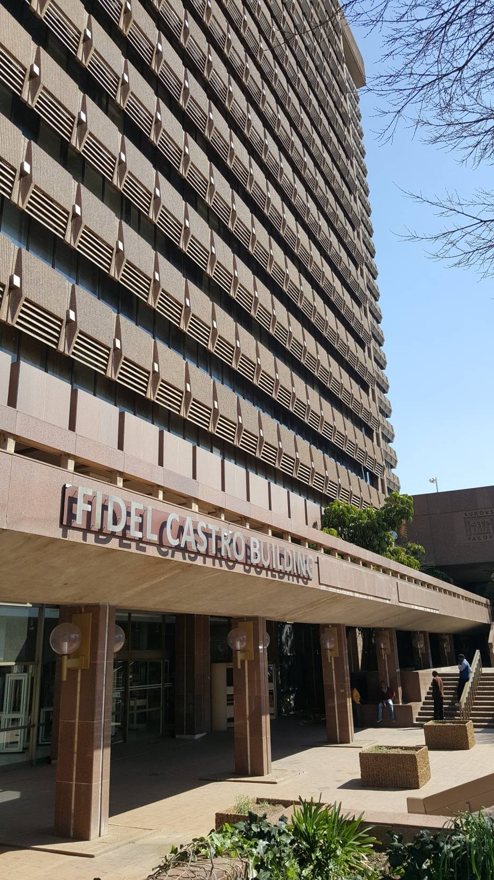
TRAINING OF CHIEF INVIGILATORS NSC 2017

Slide 2
PRESENTATION OUTLINE
Introduction
Registrations for NSC 2017
SC(a) online Registration
SBA
Commitment by learners to exams
Signing of the Pledge
Talking to Grade 12 learners
2017 Timetables
Marking arrangements
Reconfiguration of exam processes
The Well Done! Function
Review of previous exams irregularities

Slide 3
INTRODUCTION
For 2017, DBE conducted the State of Readiness of the conduct, administration and management of the mid year examinations
Good practices were identified together with areas that require attention in our preparations for the end of the year examinations
The presentation will cover key areas relating to progress made by the PED in its preparations for the conduct of end of the year examinations

Slide 4
REGISTRATION: NSC 2017

Slide 5
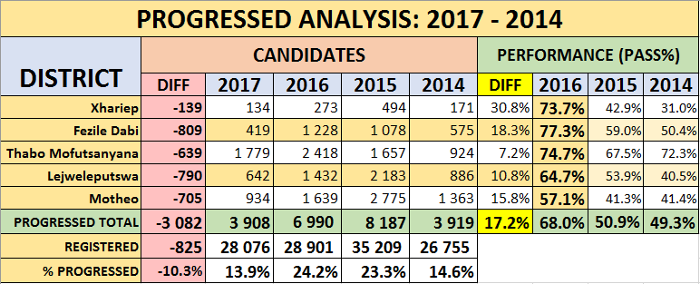
REGISTRATION: NSC 2017

Slide 6
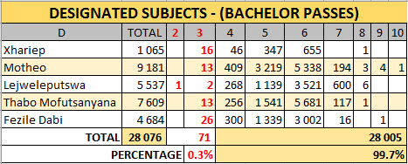
REGISTRATION: NSC 2017

Slide 7
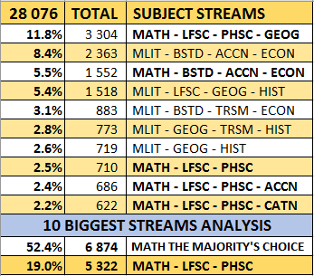
REGISTRATION: NSC 2017 – 10 BIGGEST SUBJECT STREAMS

Slide 8
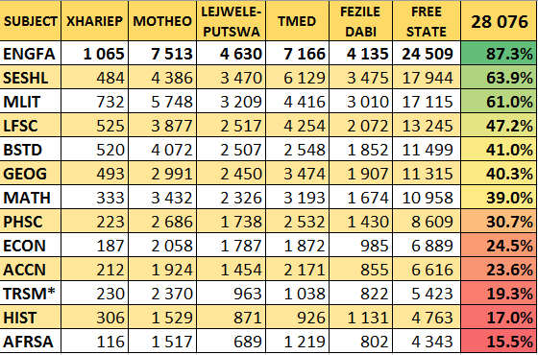
REGISTRATION: NSC 2017 – 13 BIGGEST SUBJECTS

Slide 9
SBA
Meetings were held with all Principals and HODs of all 52 schools whose SBA marks were rejected during the 2016 standardisation.
The first round of moderations were conducted from 01 to 21 June 2017.
The second round of the Grade 12 Provincial moderations will be conducted from 22 to 25 September 2017.
Subject Advisors to moderate from 01 August 2017 to 27 October 2017.
Oral Mark Sheets to be submitted by 29 September 2017.
Submission of Mark Sheets to District Offices will commence on 17 October 20017 until 27 October 2017.
The SBA capturing will commence on 27 October

Slide 10
ISSUES THAT CAN CONTRIBUTE TO THE ADJUSTMENT / REJECTION OF SBA MARKS
Standard and quality of SBA tasks.
Quality of marking and incorrect usage of rubrics.
Inability to distinguish between satisfactory, good and excellent learner responses.
Quality of internal moderation.
Quality of feedback at different levels.

Slide 11
LEARNERS’ COMMITMENT TO EXAMS

Slide 12
SIGNING OF THE PLEDGE
The rationale for the Grade 12 Pledge signing is to assist with the curbing and control of examination irregularities, such as crib notes, copying etc. The Pledge was introduced in 2013 as an attempt to adopt a more pro-active rather than a reactive approach to the reduction of examination irregularities.
We see the class of 2017 as a mature cohort of learners who will appreciate the opportunity to voluntarily sign the Pledge as something tangible to display their commitment to honesty and integrity in the writing of examinations at all times, and also to commit themselves to prepare well for the examinations.
As the signing of the Pledge will take place on 13 October 2017, schools with Grade 12 learners will use the occasion to finally wish these learners well with the exams starting on 16 October 2017 and to motivate them to study hard.

Slide 13
THE PROGRAMME FOR THE SIGNING OF THE PLEDGE
The Provincial Pledge Signing Ceremony will take at Fezile Dabi District in Kroonstad. The MEC, Ms Tshabalala, Mr Ndaba and Ms Basjan will grace the occasion.
The District Ceremonies:
LEJWELEPUTSWA: Marematlou SS, Virginia – Mr Monnane and Ms J. Nel
TMED: Mehopung PS, Ficksburg – Mr Sithole and Ms Mafojane
XHARIEP: Trompsburg SS – Mr Khoarai and Mr Mehlo
MOTHEO: Lenyora La Thuto SS, Botshabelo – HOD and Mr Montso

Slide 14
TALKING TO NSC 2017 CANDIDATES DIRECTLY
Contributed to e-Poster for advocacy of the live interactive Broadcast to 83 Secondary Schools across the Province;
Presented on 31 July 2017 for an hour from the Internet Broadcast Project (IBP) Studio, Ideas Lab, UFS South Campus;
Recorded the Presentation “Talking to NSC 2017 Candidates Directly”, also for distribution of DVDs to Provincial and District Examinations and Assessment Officials and PSLA/QLTC Forums;
To present Talk to Clusters of Schools, targeting Botshabelo and Mangaung in Motheo District, during August 2017.

Slide 15
THE 2017 END-OF-YEAR EXAMINATIONS TIMETABLES
The LO CAT will be written on 8 September 2017
The NSC 2017 Preparatory Examinations Timetable
The NSC Examinations Timetable

Slide 16
MARKING ARRANGEMENTS
Marking will commence on 4 to 15 December 2017.
The bid committee approved schools to serve as marking centers for:
- NSC December 2017(16 centres) and GETC: ABET L4 (1 centre)
- NSC re-mark 2018 (1 centre) and Supplementary 2018 (1 centre)
Internal Moderators and Chief Markers appointed for 2017 to 2021.
Selection of NSC Markers for December 2017 took place on 15 August.
NSC 2017 results will be released on 4 January 2018 and PEDs’ results on Friday, 5 January 2017.
19 January 2018: Closing date for re-marking applications.
31 January to 4 February 2018: Remarking.
17 February 2018; Re-marking results ready.

Slide 17
RECONFIGURATION OF THE EXAM SYSTEM

Slide 18
THE WELL DONE! FUNCTION
A DVD of the 2016 Well Done! Function held on 05 January 2017 will be provided to each school, to be viewed by Grades 11 and 12 learners as a preview of the event to come.
The event for the class of 2017 will be held on Friday, 5 January 2018, at the Boet Troskie Hall of the Central University of Technology in Bloemfontein.

Slide 19
Review of previous exams irregularities
NSC November / December 2016
Administrative | Serious
Unregistered candidates | Crib notes/ unauthorised materials (Cell phone)
Incorrect exam number | Different handwritings
Computer related problems | Assistance from fellow candidates
Incorrect subject level

Slide 20
Review of previous exams irregularities
SC (a) May / July 2017
Administrative | Serious
Unregistered candidates | Crib notes/ unauthorised materials (Cell phone)
Incorrect exam number

Slide 21
Thank you

